Slide 1


ESUN Money Laundering Detection Competition
Group 11
👑Debby(King of the IDEAL Lab, Boss of the Kingdom, $300M employer)
👸Kevin(Singer of the Island, Wanderer of the World) 😏Jerry(Lover of Dave(team leader and mentor), Money Treasurer in Taiwan) 🚀Brian(Dark knight, Revenger from the corruption) 🈹Louis(Dishwasher, IDEAL lab Owner and Mentor)
Copyright © 2022 All Rights Reserved by Ideal Lab(理想實驗室)

Slide 2

Outline
Introduction
Related Work
Preprocessing
Model Structure
Experiments
Summary

Slide 3
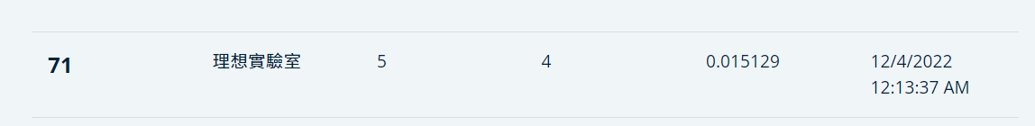


Introduction
Using XGboost dataset: cust_info
Using LSTM (Final Public Leadership Result)
72% growth

Slide 4

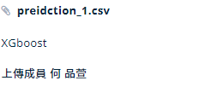
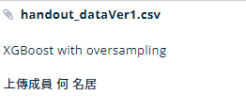

Related Work
1. Sampling
the number of normal transactions far exceeds the number of money laundering ones.
➔ Hence We try OverSampling, which involves increasing the number of money laundering transactions to match the number of normal ones, to deal with the problem.
➔ However, the result get worse. Finally, we give up sampling method during whole process.

Slide 5
Related Work
2. Parameter Models versus Non-Parameter Models
(rule based) a type of learning model that represents data using a fixed number of parameters that can be estimated from the data.
Parameter Models
Parameter Models
Non-Parameter Models
Non-parameter models are those that do not have a fixed structure or parameters and do not assume anything about the distribution of the data
Three Advantages of using Non-Parameter Models
Pattern
Finding
Adaptability
Flexibility
In short,
We choose Non-Parameter Models

Slide 6
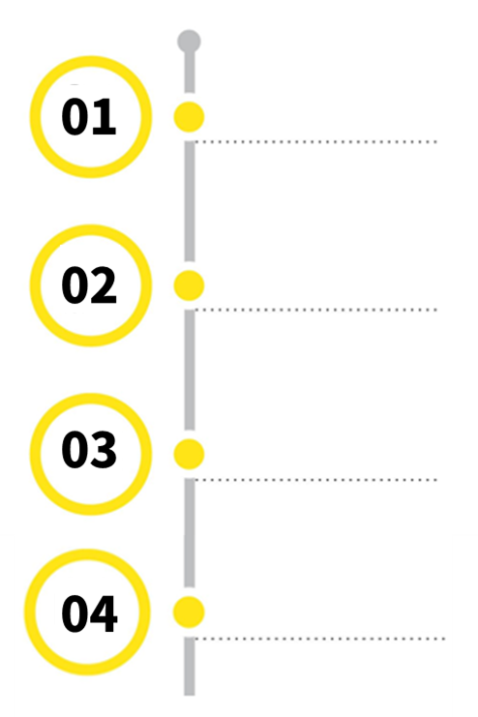
Preprocessing
Main Principles
Categorical
Numerical
Missing Value(fill in)
Mode Value
Median Value
Set Upper/Lower bound
(using boxplot)
Outlier
Normalize
min/max scale to (0,1)
Transform
One-hot encode
Notes:
using boxplot
remove outlier
>Q3+1.5*IQR
<Q1-1.5*IQR

Slide 7
Preprocessing
Dataset Preparation
Customer Info
dp
cdtx
cust_info_ count | occurrence | numeric
dp_count | occurrence | numeric
ccba_ count | occurrence | numeric
cdtx_count | occurrence | numeric
remit_ count | occurrence | numeric
total_amount | change to NTD currency | numeric
foreign | Whether international exchage | category(0/1)
cash_from_ counter | Whether change from counter | category(0/1)
is_in _taiwan | whether transact in Taiwan | cat(0/1)
is_ taiwan_ cur | whether transact in NTD | cat(0/1)
Notes:
using boxplot
remove outlier
>Q3+1.5*IQR
<Q1-1.5*IQR

Slide 8
Model Structure
Output
Dense
dp-
embedding
ccba-
embedding
cdtx-
embedding
remit-
embedding
custinfo
LSTM
LSTM
LSTM
LSTM
LSTM + NNlayers Loss function:BCE Optimizer = Adam Activation = softmax Hidden_activation = relu with imbalanced weight
dp-d5
ccba-d5
cdtx-d5
remit-d5
……
……
……
……
dp-d1
ccba-d1
cdtx-d1
remit-d1

Slide 9

Experiments
If guess 0 to 1, give penalty ‘0.5’
1. Change Weight
If guess 1 to 0, give penalty in different multiplier(52,34,26)
 | Precision |  |  | Recall
weight setting | (0.5, 52) | (0.5, 34) | (0.5, 26) | (0.5, 52) | (0.5, 34) | (0.5, 26)
 | 0.02 | 0.05 | 0.03 | 0.25 | 0.39 | 0.27

Slide 10
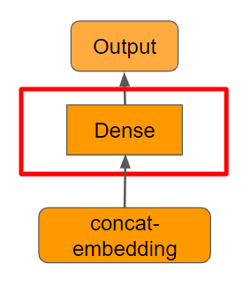
Experiments
2. Change Layer
We change the number of layers in dense layer
 | Precision |  |  | Recall
layer setting | 6NN layer | 3NN layer | 2NN layer | 6NN layer | 3NN layer | 2NN layer
 | 0.03 | 0.03 | 0.03 | 0.25 | 0.41 | 0.53

Slide 11
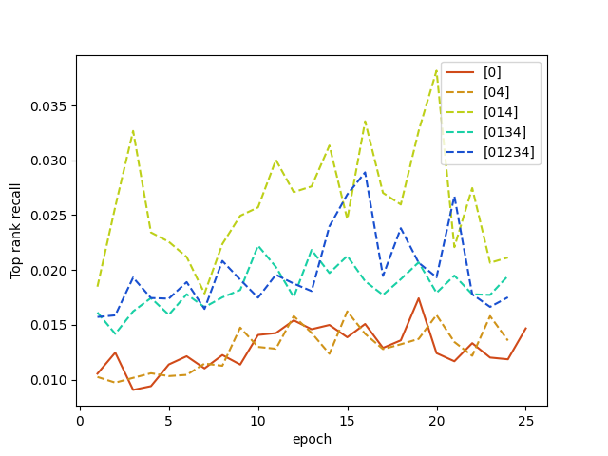
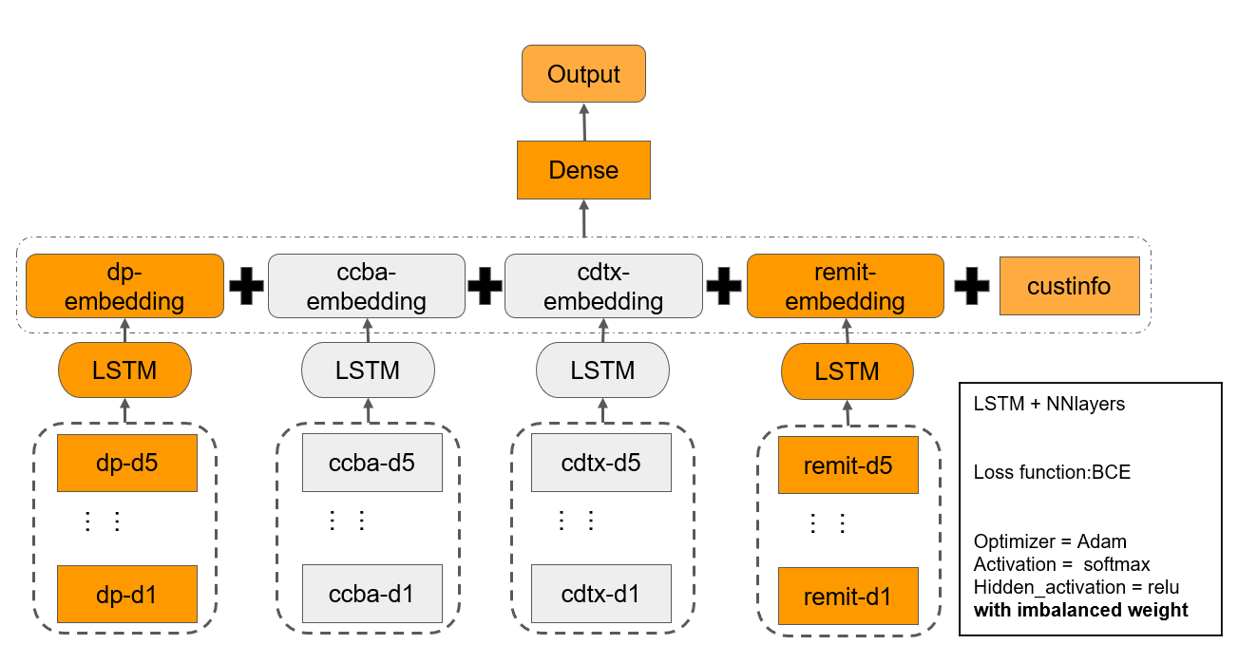
Experiments
3. Change Dataset
(0:customer information, 1: dp, 2:ccba, 3:cdtx, 4:remit)

Slide 12
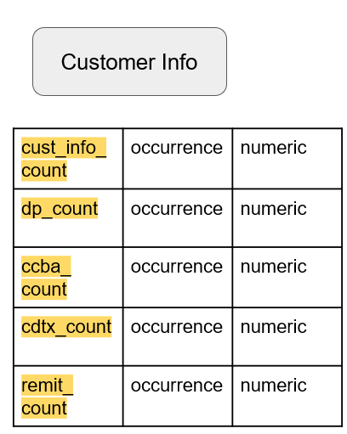
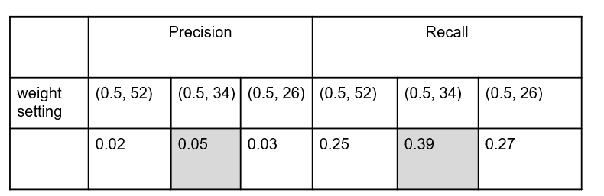
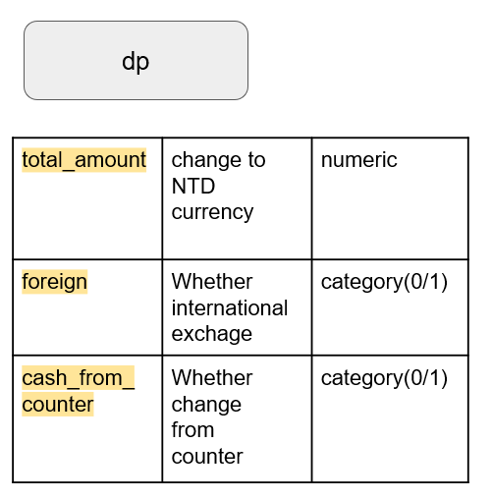
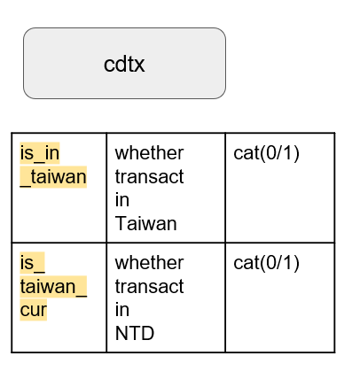
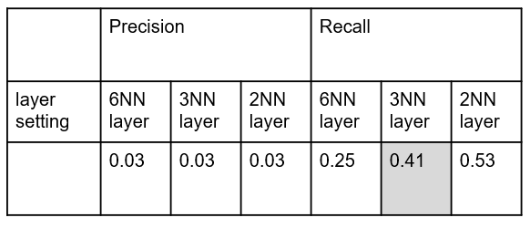
Recap
Preprocessing
Put data into model
Fine-Tune
1. Change Weight
2. Change Layer
3. Change Dataset

Slide 13

Thanks

